Slide 1
Introduction to Shiny
Linda Dib and Frédéric Schütz

Slide 2
Your turn: Exercise 1 Build and learn

Slide 3
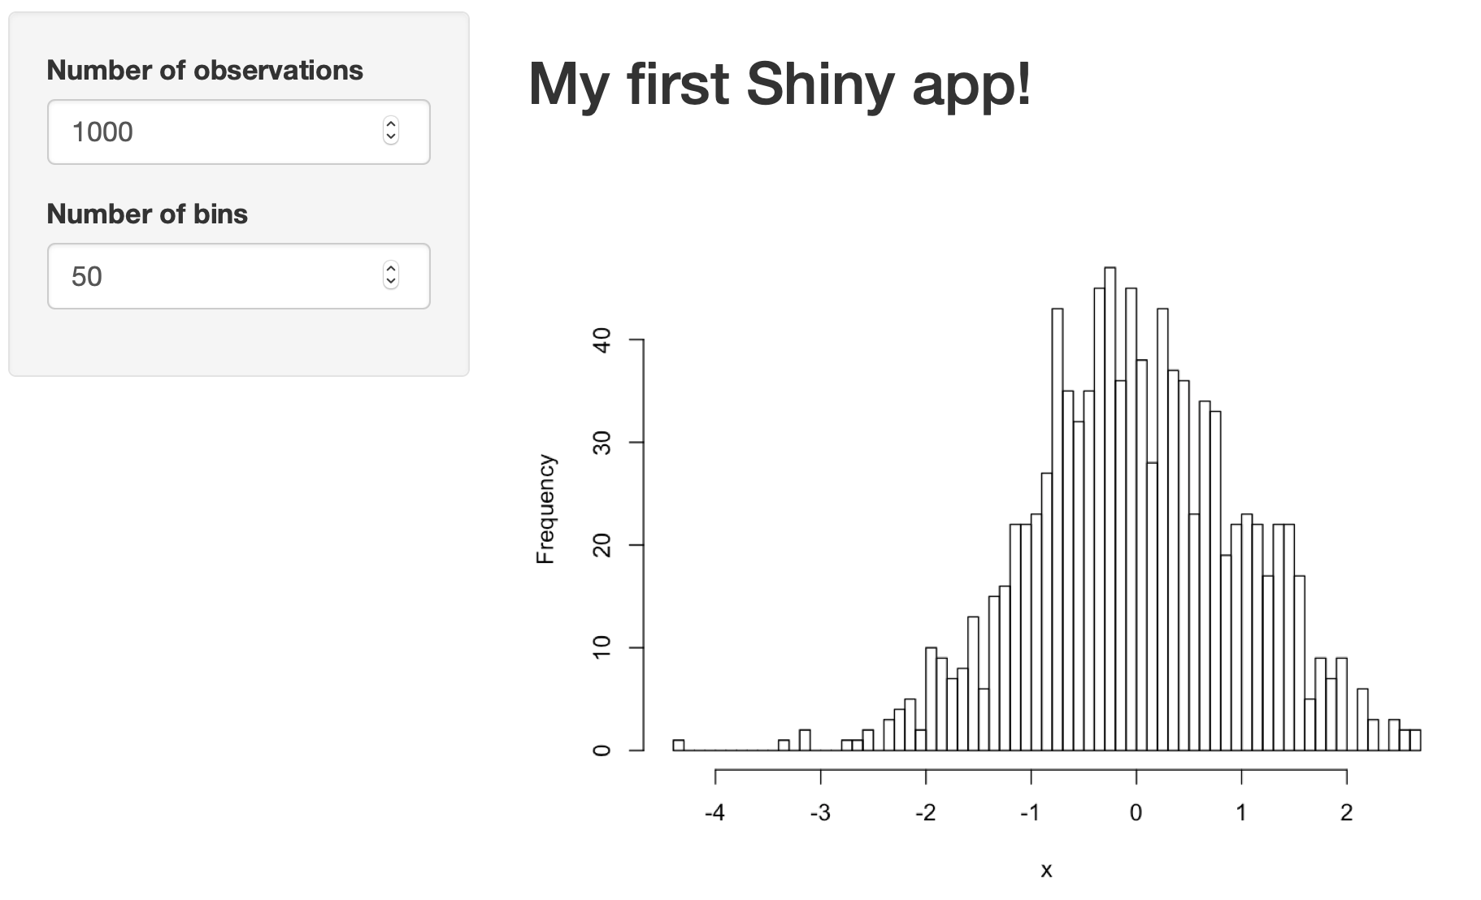
My Fist Shiny App

Slide 4
inputId and outputId
ui<- fluidPage(
titlePanel("Workshop - Example 1 – Basic Histogram"),
sidebarLayout(
sidebarPanel(
numericInput(inputId="n", label="Number of observations", value=1000)
),
mainPanel(plotOutput("plot"))
)
)
server<-function(input, output) {
data <- reactive({
x <- rnorm(input$n)
x
})
output$plot <- renderPlot({
hist(data(), 50,main="", xlab="x")
})
}
shinyApp(ui,server)

Slide 5
Solution Change the application app1 to add the bins
shinyUI(fluidPage(
titlePanel("Workshop - Example 1 – Basic Histogram"),
sidebarLayout(
sidebarPanel(
numericInput(inputId="n", label="Number of observations",
value=1000),
numericInput(inputId="bins",
label="Number of bins",value=50)
),
mainPanel(
plotOutput("plot")
)
)
))
shinyServer(function(input, output) {
data <- reactive({
x <- rnorm(input$n)
x
})
output$plot <- renderPlot({
hist(data(),input$bins,main="",
xlab="x")
})
})

Slide 6
Solution: How to add text
shinyServer(function(input, output) {
data <- reactive({
x <- rnorm(input$n)
x
})
output$text <- renderText({
"<h2>My first Shiny app!</h2>"
})
output$plot <- renderPlot({
hist(data(),input$bins,main="",
xlab="x")
})
})
shinyUI(fluidPage(
titlePanel("Workshop - Example 1 – Basic Histogram"),
sidebarLayout(
sidebarPanel(
numericInput(inputId="n", label="Number of observations",
value=1000),
numericInput(inputId="bins",
label="Number of bins",value=50)
),
mainPanel(
uiOutput(“text”),
plotOutput("plot")
)
)
))

Slide 7
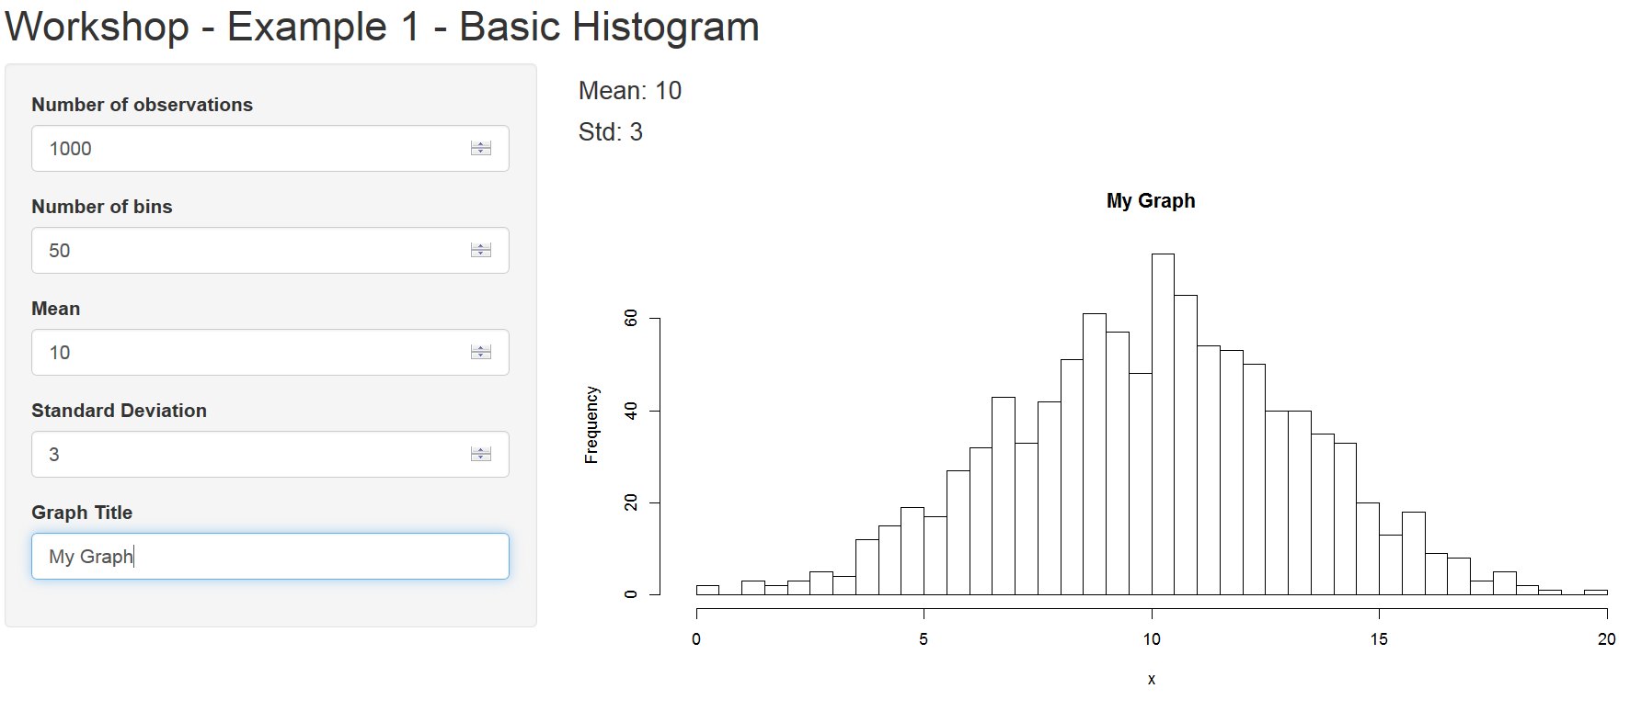
Solution: Mean and stdv

Slide 8
Solution: Mean and stdv
shinyUI(fluidPage(
titlePanel("Workshop - Example 1 - Basic Histogram"),
sidebarLayout(
sidebarPanel(
numericInput(inputId="n", label="Number of
observations",value=1000),
numericInput(inputId="bins", label="Number of
bins",value=50),
numericInput(inputId="mu",
label="Mean",value=0),
numericInput(inputId="sig", label="Standard
Deviation",value=1),
textInput("ttl","Graph Title",value="")
),
mainPanel(
uiOutput("text"),
plotOutput("plot")
)
)
))
shinyServer(function(input, output) {
data <- reactive({
x <- rnorm(input$n,input$mu,input$sig)
x
})
output$text <- renderText({
line <- paste("<h4>Mean:",input$mu,"</h4>")
line[2] <- paste("<h4>Std:",input$sig,"</h4>")
line
})
output$plot <- renderPlot({
hist(data(),input$bins,main=input$ttl,xlab="x")
})
})

Slide 9
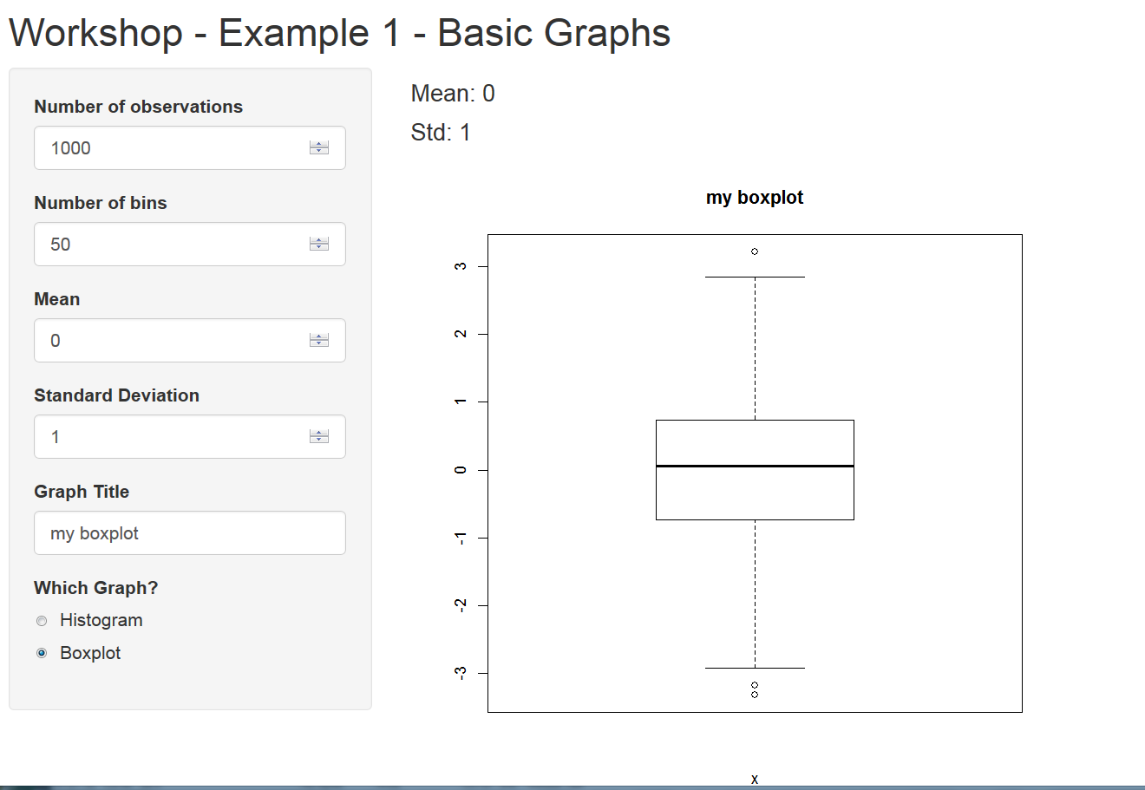
Solution: different displays

Slide 10
Solution: different displays
shinyUI(fluidPage(
titlePanel("Workshop - Example 1 - Basic Graphs"),
sidebarLayout(
sidebarPanel(
numericInput(inputId="n", label="Number of observations",value=1000),
numericInput(inputId="bins",
label="Number of bins",value=50),
numericInput(inputId="mu",
label="Mean",value=0),
numericInput(inputId="sig",
label="Standard Deviation",value=1),
textInput("ttl","Graph Title",value=""),
radioButtons(inputId="whichgraph", label="Which Graph?", choices=c("Histogram","Boxplot")
),width=3
),
mainPanel(
uiOutput("text"),
plotOutput("plot", width = "500px", height = "500px")
)
)
))
shinyServer(function(input, output) {
data <- reactive({
x <- rnorm(input$n,input$mu,input$sig)
x
})
output$text <- renderText({
line <- paste("<h4>Mean:",input$mu,"</h4>")
line[2] <- paste("<h4>Std:",input$sig,"</h4>")
line
})
output$plot <- renderPlot({
if(input$whichgraph=="Histogram")
hist(data(),input$bins,main=input$ttl,xlab="x")
else
boxplot(data(),main=input$ttl,xlab="x")
})
})

Slide 11
Solution: Panel appear & disappear:
shinyUI(fluidPage(
titlePanel("Workshop - Example 1 - Basic Graphs"),
sidebarLayout(
sidebarPanel(
numericInput(inputId="n", label="Number of observations",value=1000),
conditionalPanel(condition = "input.whichgraph=='Histogram'",
numericInput(inputId="bins", label="Number of bins",value=50)
),
numericInput(inputId="mu", label="Mean",value=0),
numericInput(inputId="sig", label="Standard Deviation",value=1),
textInput("ttl","Graph Title",value=""),
radioButtons(inputId="whichgraph",label="Which Graph?",
choices=c("Histogram","Boxplot")),width=3
),
mainPanel(
uiOutput("text"),
plotOutput("plot", width = "500px", height = "500px")
)
)
))

Slide 12
Solution: File Input
shinyUI(fluidPage(
titlePanel("Workshop - Example 1 - Basic Graphs"),
sidebarLayout(
sidebarPanel(
selectInput("dataset", HTML("<h5>Choose a dataset:</h5>"),
choices = c("Newcomb's Speed of Light",
"Weight of Euro Coins","Forbes 500","Random"),selected="Random"),
conditionalPanel(condition = "input.dataset=='Random'",
numericInput(inputId="n", label="Number of observations",value=1000),
conditionalPanel(condition = input.whichgraph=='Histogram'",
numericInput(inputId="bins", label="Number of bins",value=50)
),
numericInput(inputId="mu", label="Mean",value=0),
numericInput(inputId="sig", label="Standard Deviation",value=1),
textInput("ttl","Graph Title",value="")
),
radioButtons(inputId="whichgraph",label="Which Graph?",
choices=c("Histogram","Boxplot")),width=3
),
mainPanel(
uiOutput("text"),
plotOutput("plot", width = "500px", height = "500px")
)
)
))
shinyServer(function(input, output) {
data <- reactive({
if(input$dataset=="Random")
return(rnorm(input$n,input$mu,input$sig))
if(input$dataset=="Newcomb's Speed of Light") {
source("newcomb.R")
return(newcomb)
}
if(input$dataset=="Weight of Euro Coins") {
source("euros.R")
return(euros)
}
if(input$dataset=="Forbes 500") {
source("forbes.R")
return(forbes$Assets)
}
})
output$text <- renderText({
if(input$dataset!="Random") return("")
line <- paste("<h4>Mean:",input$mu,"</h4>")
line[2] <- paste("<h4>Std:",input$sig,"</h4>")
line
})
output$plot <- renderPlot({
if(input$dataset=="Random") ttl<-input$ttl
else ttl <- input$dataset
if(input$whichgraph=="Histogram")
hist(data(),input$bins,main=ttl,xlab="x")
else
boxplot(data(),main=ttl,xlab="x")
})
})

Slide 13
Solution: Text Output
output$text <- renderText({
x <- data()
line <- "<table border=1>"
line[2] <- "<tr><th>Sample Size</th>
<th>Mean</th><th>Standard Deviation</th></tr>"
line[3] <- paste("<tr><td>",length(x),
"</td><td>",round(mean(x),2),
"</td><td>",round(sd(x),3),"</td></tr>")
line[4] <- "</table>"
line
})

Slide 14
Solution: Tables appearance
shinyUI(fluidPage(
tags$head(
tags$style(HTML("
table, th, td {
text-align:right;
}
th, td {
padding: 10px;
}
"))
),
titlePanel("Workshop - Example 1 - Basic Graphs"),

Slide 15
Solution: Panels
mainPanel(
tabsetPanel(
tabPanel("Statistics",uiOutput("text")),
tabPanel("Graphs",plotOutput("plot", width =
"500px", height = "500px")),
id="Tabs"
)
)

Slide 16
Solution: Selection
conditionalPanel( condition = "input.Tabs == 'Graphs'",
radioButtons(inputId="whichgraph",
label="Which Graph?",
choices=c("Histogram","Boxplot")),
conditionalPanel(condition =
"input.dataset=='Random'",
textInput("ttl","Graph Title",value=""))
)

Slide 17
Solution: Animation
In ui.R:
sliderInput("k","Repeat!",min=1, max=10, value=0,step=1,
animate=animationOptions(interval = 500,playButton=“Go!")
)
In server.R:
if(input$dataset=="Random") {
for(i in 1:input$k) mu<-input$mu
return(rnorm(input$n,input$mu,input$sig))
}

Slide 18
Solution: Using libraries
In server.R:
require(ggplot2)
shinyServer(function(input, output) {
…
output$plot <- renderPlot({
if(input$dataset=="Random") ttl<-input$ttl
else ttl <- input$dataset
dta<-data.frame(x=data())
if(input$whichgraph=="Histogram") {
bw <- diff(range(data()))/input$bins
plt <- ggplot(data=dta,aes(x))+
geom_histogram(aes(y = ..density..),color="black",fill="white", binwidth = bw)
}
else
plt <- ggplot(data=dta,aes(factor(1,length(x)),x))+
geom_boxplot()
plt <- plt + xlab(ttl)+ylab("")
print(plt)
})

